Slide 1
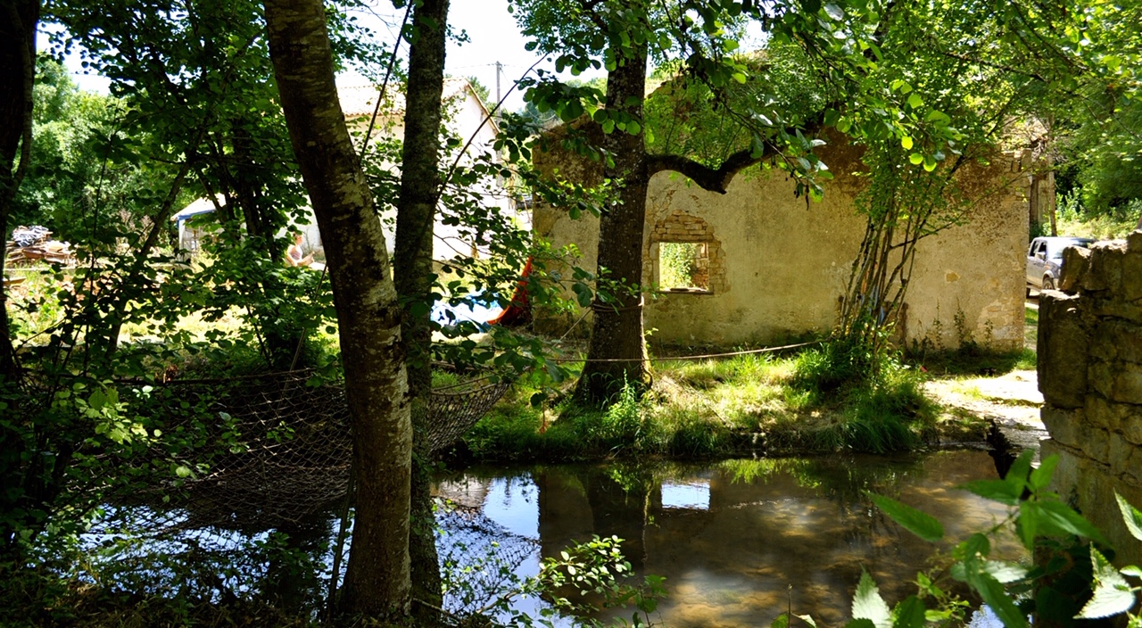
France - Nanteuil en Vallée
VILLOGNON WATERMILL
From August 5th (arrival)
to August 19th (departure)
ERASMUS
Live a European experience
with Heritage !
HERITAGE VOLUNTEERS and LEADERS

Slide 2
ERASMUS
HERITAGE VOLUNTEERS and LEADERS
WHERE? In France - Nanteuil en Vallée
WHEN? From 05/08 to 19/08
WHAT? A European youth exchange supported by ERASMUS plus in order to share heritage conservation skills and restore the ancient Villognon watermill.
WHO? 32 volunteers from 17 yo to 30 yo from France, Croatia, Malta and United Kingdom.
BOARD AND LODGING? All costs are covered by the project (food, accomodation under tents provided on site, visits, activities). There is just 30 euros of registration fee for the full duration of your stay.
TRANSPORT? If possible, please arrive at the Ruffec-Charente train station in the afternoon of the 5th of August. Departure from the same station the last day (19/08), Specific arrangement can be made with our local leaders. An ERASMUS grant of 275 euros per person will be offered to cover the transportation cost. This will be reimbursed to the volunteers in a maximum of 30 days after the end of the project.

Slide 3
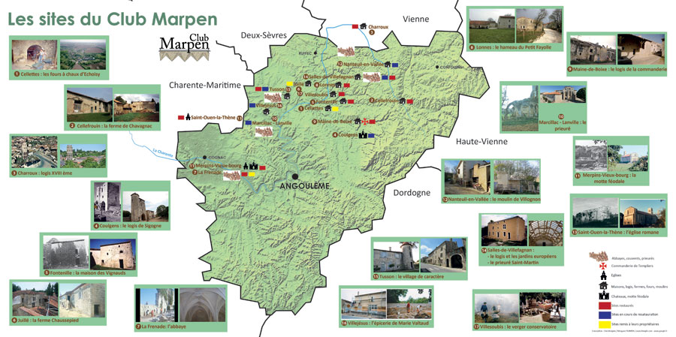
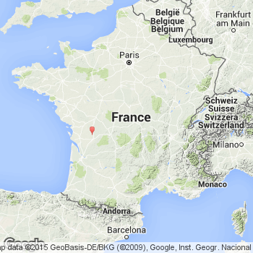
ERASMUS

